Slide 1

Guest Lecture
Bodo Linz
09/13/18

Slide 2
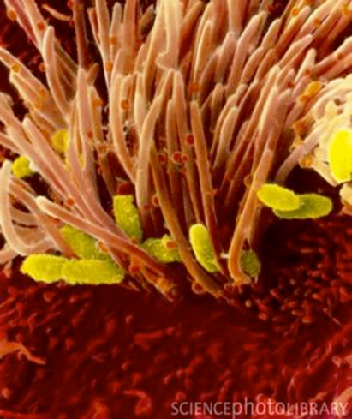
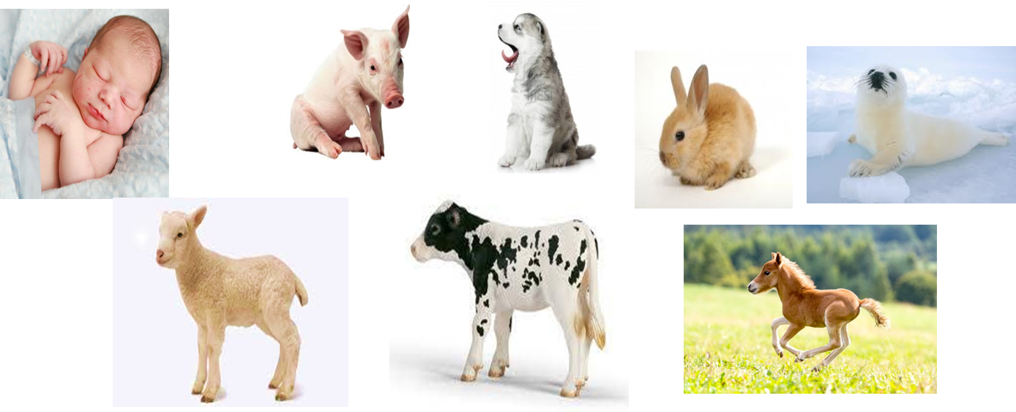
The Bordetellae
Beta-Proteobacteria
Include the classical bordetellae:
B. bronchiseptica
B. parapertussis
B. pertussis

Slide 3
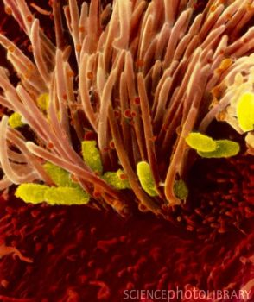
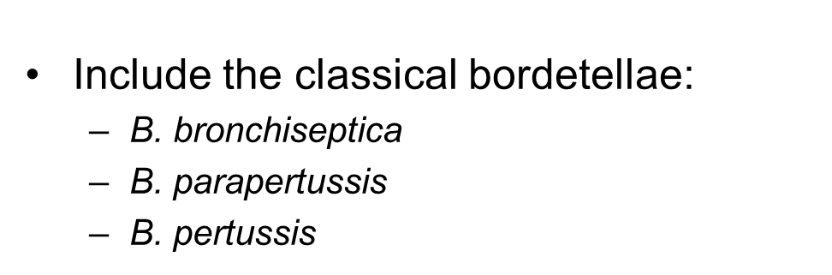
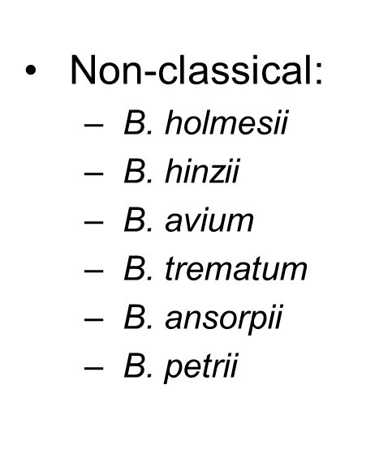
The Bordetellae
respiratory pathogens in animals and
in immuno-compromized humans
wound and ear infection in humans
environmental / ear infection in humans
+ several other recently described species

Slide 4
Neighbor-joining trees of 16S rRNA gene sequences and
8 concatenated ATP synthase proteins from Bordetella
A) 16S rRNA
B. bronchiseptica
classical bordetellae
B. parapertussis
B. pertussis
B. hinzii
B. holmesii
B. trematum
B. petrii
B. avium
B. ansorpii
Burkholderia
0.01
B) ATP synthase
B. holmesii
B. hinzii
B. avium
B. pertussis
B. trematum
B. bronchiseptica
classical bordetellae
B. parapertussis
B. petrii
Ralstonia
B. ansorpii
Burkholderia
0.05

Slide 5
128 Bordetella genomes
95 classical bordetellae:
58 B. bronchiseptica
2 B. parapertussis
34 B. pertussis
respiratory pathogens in
animals and humans
34 non-classical bordetellae:
18 B. holmesii
6 B. hinzii
1 B. avium
4 B. trematum
2 B. ansorpii
3 B. petrii
respiratory pathogens in animals and
in immuno-compromized humans
wound and ear infection in humans
environmental / ear infection in humans

Slide 6
questions
virulence-associated factors determining host specificity?
virulence-associated factors determining disease outcome?

Slide 7
Approach
genome-wide SNP-based phylogenetic tree
genome-wide presence/absence of genes
similar evolutionary trends?
Pairwise genome comparisons (ACT)
(Artemis Comparison Tool)
mapping of virulence-associated genes
Principle Components Analysis (PCA)
ACT: https://www.sanger.ac.uk/science/tools/artemis-comparison-tool-act

Slide 8
Approach
genome-wide SNP-based phylogenetic tree
align genomes
align short reads against reference genome (SSAHA)
alignment of multiple genomes
generate phylogenetic tree

Slide 9
Approach
data format: Sequence alignment in rows
Name SEQUENCE
Name SEQUENCE
SAMPLE01C CGTTGCTGGCCGGATTTGCGCAGCAGGCGCGCGATCTCGTGGTCGTGCGCATTGACGCCCGCCCGCGCATCGACCAGGAACACCAC
SAMPLE02A CGCTGCTGGCCGGATTTGCGCAGCAGGCGCGCGATCTCGTGGTCGTGCGCATTGACGCCCGCCCGCGCATCGACCAGGAACACCAC
SAMPLE03T CGCTGCTGGCCGGACTTGCGCAGCAGGCGCGCGATCTCGTGGTCGTGCGCATTGACGCCCGCCCGCGCATCGACCAGGAACACCAC
SAMPLE-04 CGCTGCTGGCCAGATTTACGGAGC----------TTTCGTGGTCGTGCGCGTTGACGCCGGCGCGCGCGTCGACCAGGAACACCAC
SAMPLE05G CGCTGCTGGCCGGATTTGCGCAGCAGGCGGGCGATTTCGTGGTCGTGCGCGTTGATGCCGGCACGGGCATCGACCAGGAACACGAC
SAMPLE06 CGCTGCTGGCCGGACTTGCGCAGCAGGCGGGCGATCTCGTGGTCATGCGCGTTGATCCCCGCCCGCGCGTCGACCAGGAAGACCAC
SAMPLE-7A CGCTGCTGACCGGACTTACGCAG---------------------------------------------------------------
SAMPLE08B CGCTGCTGGCCGGACTTGCGCAACAAGCGGGCGAT-----------------------CGGCCCGGGCGTCGACCAGGAACACCAC
SAMPLE09 CGCTGCTGCCCGGACTTGCGCAACAGGCGGGCGAT--------------------------------------------ACACCAC
Data format: 1 reference genome (5.3 MB), all other genomes aligned against it
Problem: missing data (dashes)
- gene not present
- gene so divergent that the sequence did not align
- multiple copies of a gene
Solution: remove all positions with missing data in any of the genomes

Slide 10
Approach
data format: Sequence alignment in rows
Name SEQUENCE
Name SEQUENCE
$1 $2 $1 = field 1; $2 = field 2
SAMPLE01C CGTTGCTGGCCGGATTTGCGCAGCAGGCGCGCGATCTCGTGGTCGTGCGCATTGACGCCCGCCCGCGCATCGACCAGGAACACCAC
SAMPLE-04 CGCTGCTGGCCAGATTTACGGAGC----------TTTCGTGGTCGTGCGCGTTGACGCCGGCGCGCGCGTCGACCAGGAACACCAC
SAMPLE05G CGCTGCTGGCCGGATTTGCGCAGCAGGCGGGCGATTTCGTGGTCGTGCGCGTTGATGCCGGCACGGGCATCGACCAGGAACACGAC
SAMPLE-7A CGCTGCTGACCGGACTTACGCAG---------------------------------------------------------------
awk: change strain names to lower case and replace '-' by '_'
- python: replace nucleotides by nucleotides plus tab
awk: remove extra tab at the end of each line
python: transpose rows to columns
awk: select only core loci
grep | wc: determine the number of loci in the resulting file
python: replace nucleotides by numbers
R: calculate matrix
python: transpose columns to rows
awk: add extra tab at the end of each line
python: replace nucleotides plus tab by nucleotides

Slide 11
Approach
data format: Sequence alignment in rows
Name SEQUENCE
Name SEQUENCE
$1 $2 $1 = field 1; $2 = field 2
SAMPLE01C CGTTGCTGGCCGGATTTGCGCAGCAGGCGCGCGATCTCGTGGTCGTGCGCATTGACGCCCGCCCGCGCATCGACCAGGAACACCAC
SAMPLE-04 CGCTGCTGGCCAGATTTACGGAGC----------TTTCGTGGTCGTGCGCGTTGACGCCGGCGCGCGCGTCGACCAGGAACACCAC
SAMPLE05G CGCTGCTGGCCGGATTTGCGCAGCAGGCGGGCGATTTCGTGGTCGTGCGCGTTGATGCCGGCACGGGCATCGACCAGGAACACGAC
SAMPLE-7A CGCTGCTGACCGGACTTACGCAG---------------------------------------------------------------
need to manipulate nucleotide sequence in all rows
problem: same letters in sequence names
solution: sequence name lower case, sequence upper case,
dashes in names as underline
awk: change strain names to lower case and replace '-' by '_'
MAKE THE SCRIPT USER FRIENDLY!!!
- write instructions to yourself
- let the computer display what it’s currently doing

Slide 12
awk: change strain names to lower case and replace '-' by '_‘
#!/bin/bash
# PhyGenome_Align_remove_missing_data.sh
# remove variably present loci, keep only core loci
# enter file names as needed
FILESNP="128genomes.phy"
NAMESNP=${FILESNP%%".phy"}
echo ""
echo "load input file $NAMESNP"
echo ""
echo "awk: change strain names to lower case and '-' to '_'"
echo "-----------------------------------------------------"
# make sequence name lower case
cat $FILESNP | awk -v FS="\t" -v OFS="\t" '{$1=tolower($1); print $0}' > fake
Let’s go through this command →
write instructions to yourself
you can either define the input file once or enter it again and again throughout the script
echo “ ” - let the computer display to the user what it is currently doing

Slide 13
awk: change strain names to lower case and replace '-' by '_‘
# make sequence name lower case
cat $FILESNP | awk -v FS="\t" -v OFS="\t" '{$1=tolower($1); print $0}' > fake
# cat – concatenate
# open 1 file, open and combine (=concatenate) several files
# | pipe - string several commands together into a pipeline
# - input from memory, output into memory
# FS="\t" – Field Separator is tab: $1 $2
# OFS="\t" – Output Field Separator is tab
# '{}' – what to do
# $1=tolower($1) – new field $1 is lower case of current $1
# print $0 – print all fields
# > save as

Slide 14
awk: change strain names to lower case and replace '-' by '_‘
# make sequence name lower case
cat $FILESNP | awk -v FS="\t" -v OFS="\t" '{$1=tolower($1); print $0}' > fake
# replace (substitute) "-" to "_" in strain names
cat $FILESNP | awk -v FS="\t" -v OFS="\t" '{gsub(/-/,"_",$1); print $0}' > fake
# Why "gsub" and not "sub"? imagine strain name: M1989-03-14
awk '{sub(/-/"_",$1);print $0}'
# replaces only 1st instance: M1989_03-14
awk '{gsub(/-/,"_",$1);print $0}'
# replaces ALL instances in a line: M1989_03_14

Slide 15
awk: change strain names to lower case and replace '-' by '_‘
# make sequence name lower case
cat $FILESNP | awk -v FS="\t" -v OFS="\t" '{$1=tolower($1); print $0}' > fake
# replace (substitute) "-" to "_" in strain names
cat $FILESNP | awk -v FS="\t" -v OFS="\t" '{gsub(/-/,"_",$1); print $0}' > fake
Let’s pipe it:
# replace "-" to "_" in strain names and lower case
cat $FILESNP | awk -v FS="\t" -v OFS="\t" '{$1=tolower($1); print $0}' | awk -v FS="\t" -v OFS="\t" '{gsub(/-/,"_",$1); print $0}' > fake
SAMPLE01C CGTTGCTGGCCGGATTTGCGCAGCAGGCGCGCGATCTCGTGGTCGTGCGCATTGACGCCCGCCCGCGCATCGACCAGGAACACCAC
SAMPLE-04 CGCTGCTGGCCAGATTTACGGAGC----------TTTCGTGGTCGTGCGCGTTGACGCCGGCGCGCGCGTCGACCAGGAACACCAC
sample01c CGTTGCTGGCCGGATTTGCGCAGCAGGCGCGCGATCTCGTGGTCGTGCGCATTGACGCCCGCCCGCGCATCGACCAGGAACACCAC
sample_04 CGCTGCTGGCCAGATTTACGGAGC----------TTTCGTGGTCGTGCGCGTTGACGCCGGCGCGCGCGTCGACCAGGAACACCAC

Slide 16
python: transpose rows to columns
# insert tab after each nucleotide to get independent loci, input_file "fake", output_file "fake2"
echo ""
echo "python: replace nucleotides by numbers plus tab"
echo "-----------------------------------------------------"
python2.6 ../../bin/replace_nucs_to_nucsplustab_in_file.py
# call python v2.6 # where is the script
sample01c CGTTGCTGG...
sample_04 CGCTGCTGG...
sample01c C G T T G C T G G
sample_04 C G C T G C T G G

Slide 17
Python script: replace_nucs_to_nucsplustab_in_file.py
#!/usr/bin/env python
input = open('fake', "r")
output = open('fake2', "w")
stext1 = 'A' rtext1 = 'A\t'
stext2 = 'C' rtext2 = 'C\t'
stext3 = 'G' rtext3 = 'G\t'
stext4 = 'T' rtext4 = 'T\t'
stext5 = '-' rtext5 = 'Z\t'
stext6 = 'N' rtext6 = 'Z\t'
output.write(input.read().replace(stext1, rtext1).replace(stext2, rtext2).replace(stext3, rtext3).replace(stext4, rtext4).replace(stext5, rtext5).replace(stext6, rtext6))
# why Z? Any letter not A C G T or N will do
(or not IUPAC depending on what you wanna do)

Slide 18
awk: remove extra tab ta the end of the line
# remove extra tab at the end of each line
echo ""
echo "awk: remove extra tab at the end of each line"
echo "----------------------------------------------------"
cat fake2 | awk -v FS="\t" -v OFS="\t" '{sub(/[ \t]+$/, ""); print $0}' > fake3
- python: transpose rows to columns
# transform rows to columns
echo ""
echo "python: transpose rows to columns"
echo "----------------------------------------------------"
cat fake3 | python2.6 ../../bin/rows2columns_transposition.py > fake4
# This time we pipe python. Input from memory, output to memory.

Slide 19
Python script: rows2columns_transposition.py
#!/usr/bin/env python
"""
rows_to_colums_transposition.py
input(sys.stdin) : A file with strains and tab separated loci in rows
output (sys.stdout): A file with strains and loci in columns
"""
import sys
for c in zip(*(l.strip().split() for l in sys.stdin.readlines() if l.strip())):
print('\t'.join(c))

Slide 20
awk: select core loci (no missing data)
The story so far:
- we renamed $1 to lower case and changed “–” to “_”
- we replaced missing data (“-”, “N”) with “Z”
- we transposed rows to columns
sample1c sample_04 sample05g sample_7a
A G A A
A G T T
A G Z Z
C C C T
# select only rows that do not contain "Z" (=core loci only)
echo ""
echo "selecting core loci"
cat fake4 | grep -v "Z" > fake5
# grep – global regular expression print – (“grab”)
# -v --invert-match (select all lines that do not contain Z)

Slide 21
awk: select core loci (no missing data)
The story so far:
- we renamed $1 to lower case and changed “–” to “_”
- we replaced missing data (“-”, “N”) with “Z”
- we transposed rows to columns
- we selected core loci
sample1c sample_04 sample05g sample_7a
A G A A
A G T T
C C C T
How many loci did we end up with?
# determine the number of loci in the resulting file
cat fake5 | grep -v s | wc -l > fake5a
echo "The dataset from file '$NAMESNP' consists of $(cat fake5a) core loci. "
# grep -v s – select all lines that do not contain “s”
# wc -l – word count, count the number of lines (-l)
# cat fake5a – open file fake5a, which is just a number

Slide 22
awk: select core loci (no missing data)
The story so far:
- we renamed $1 to lower case and changed “–” to “_”
- we replaced missing data (“-”, “N”) with “Z”
- we transposed rows to columns
- we selected core loci
sample1c sample_04 sample05g sample_7a
A G A A
A G T T
C C C T
How many loci did we end up with?
# determine the number of loci in the resulting file
# grep -v s – requires a common character (“s”)in all names
# alternatively:
cat fake5 | awk 'NR>1' | wc -l > fake5a
# awk 'NR>1' – select all lines (=rows) after the first

Slide 23
- python: transpose rows to columns
# transform rows to columns
echo "python: transpose rows to columns"
echo "----------------------------------------------------"
cat fake5 | python2.6 ../../bin/rows2columns_transposition.py > fake7
cat fake7 | awk ‘{print $0”\t”}’ > fake 8
cat fake8 | python2.6 ../../bin/replace_nucs_plus_tab_by_nucs.py > fake9
awk: add extra tab at the end of each line
python: replace nucleotides plus tab by nucleotides

Slide 24
write final output file
echo ""
echo "awk: writing output file"
echo "----------------------------------------------------"
cat fake9 | awk -v FS="\t" -v OFS="\t" '{print $1,$2}' > $NAMESNP-no-gaps.phy

Slide 25
python: replace nucs by numbers (fake5 > fake6)
as before (stext and rtext)
R: Calculate Distance matrix
echo "R: Calculate Distance matrix."
echo "-----------------------------------------------------"
# Run R in '--slave' mode to incorporate in bash script
R --slave -f Dist_mat_Genomes.R
call R
in slave
mode
script in the
same directory
R:
another scripting language
awesome for calculations
syntax different from bash or python

Slide 26
Syntax: R vs Python
R: read file
a <-read.table(“fake6”, header=TRUE, sep=“\t”)
Python: read file
input = open('fake6', "r")
R: transpose rows to columns
y = t(x)
Python: transpose rows to columns
for c in zip(*(l.strip().split() for l in sys.stdin.readlines() if l.strip())):
print('\t'.join(c))
R: write file
write.table(m5, file = “SEQ1.dist”, sep = “\t”, row.names = FALSE, column.names = FALSE)
Python: write file
output = open('fake7', "w")

Slide 27
R: Calculate Distance matrices of SNPs and Genes
#!usr/bin/R
#delete all objects
rm(list = ls())
#load packages
library(ade4)
library(MASS)
a <-read.table(“fake6”, header=TRUE, sep=“\t”) ## load data
x = t(a) ## transform data to genomes by row and SNPs by col
SEQ1.dist <- as.dist(dist(x, “manhattan”)) ## calc matrix
m5 <- as.matrix(SEQ1.dist) ## write as matrix
write.table(m5, file = “SEQ1.dist”, sep = “\t”, row.names = FALSE, column.names = FALSE)

Slide 28
Distance matrix
0.197
0.219 0.021
0.196 0.519 0.558
0.192 0.513 0.551 0.006
0.208 0.536 0.575 0.056 0.053
0.218 0.554 0.594 0.062 0.059 0.036
0.221 0.558 0.598 0.065 0.060 0.038 0.042
0.222 0.561 0.601 0.071 0.066 0.044 0.049 0.049
0.226 0.572 0.613 0.068 0.065 0.037 0.052 0.055 0.061
0.272 0.642 0.677 0.275 0.271 0.286 0.297 0.298 0.302 0.307

Slide 29
transfer distance matrix
change to MEGA format
MEGA – Molecular Evolutionary Genetics Analysis
load matrix and display tree
MEGA format:
https://www.megasoftware.net/
#mega
Title distance matrix genome-wide SNPs in 128 Bordetella genomes;
[ 1] # sample_1a
[ 2] # sample02
[ 3] # sample3a
[ 4] # sample4c
[ 1 2 3 4 ]
[ 1]
[ 2] 0.007695584
[ 3] 0.000200096 0.007495488
[ 4] 0.00021632 0.007511712 0.000016224

Slide 30
Change matrix to MEGA format: either by hand in text editor or by scripting
echo "Writing output file."
echo ""
printf "#mega\nTitle distance matrix of genome sequences from 10 Bordetella species;\n\n" > 10gen.meg
cat 10gen.phy | awk 'NR==1' | awk -v FS="\t" -v OFS="" '{print "[ 1] #",$1}' >> 10gen.meg
cat 10gen.phy | awk 'NR==2' | awk -v FS="\t" -v OFS="" '{print "[ 2] #",$1}' >> 10gen.meg
cat 10gen.phy | awk 'NR==3' | awk -v FS="\t" -v OFS="" '{print "[ 3] #",$1}' >> 10gen.meg
cat 10gen.phy | awk 'NR==4' | awk -v FS="\t" -v OFS="" '{print "[ 4] #",$1}' >> 10gen.meg
cat 10gen.phy | awk 'NR==5' | awk -v FS="\t" -v OFS="" '{print "[ 5] #",$1}' >> 10gen.meg
cat 10gen.phy | awk 'NR==6' | awk -v FS="\t" -v OFS="" '{print "[ 6] #",$1}' >> 10gen.meg
cat 10gen.phy | awk 'NR==7' | awk -v FS="\t" -v OFS="" '{print "[ 7] #",$1}' >> 10gen.meg
cat 10gen.phy | awk 'NR==8' | awk -v FS="\t" -v OFS="" '{print "[ 8] #",$1}' >> 10gen.meg
cat 10gen.phy | awk 'NR==9' | awk -v FS="\t" -v OFS="" '{print "[ 9] #",$1}' >> 10gen.meg
cat 10gen.phy | awk 'NR==10' | awk -v FS="\t" -v OFS="" '{print "[10] #",$1,"\n"}' >> 10gen.meg
printf "[\t1\t2\t3\t4\t5\t6\t7\t8\t9\t10 ]\n" >> 10gen.meg
printf "[ 1] \n" >> 10gen.meg
cat 10gens.dist | awk 'NR==2' | awk -v FS="\t" -v OFS="" '{print "[ 2]\t",$1,“ "}' >> 10gen.meg
cat 10gens.dist | awk 'NR==3' | awk -v FS="\t" -v OFS="" '{print "[ 3]\t",$1,"\t",$2,“ "}' >> 10gen.meg
cat 10gens.dist | awk 'NR==4' | awk -v FS="\t" -v OFS="" '{print "[ 4]\t",$1,"\t",$2,"\t",$3,“ "}' >> 10gen.meg
cat 10gens.dist | awk 'NR==5' | awk -v FS="\t" -v OFS="" '{print "[ 5]\t",$1,"\t",$2,"\t",$3,"\t",$4,“ "}' >> 10gen.meg
cat 10gens.dist | awk 'NR==6' | awk -v FS="\t" -v OFS="" '{print "[ 6]\t",$1,"\t",$2,"\t",$3,"\t",$4,"\t",$5,“ "}' >> 10gen.meg
cat 10gens.dist | awk 'NR==7' | awk -v FS="\t" -v OFS="" '{print "[ 7]\t",$1,"\t",$2,"\t",$3,"\t",$4,"\t",$5,"\t",$6,“ "}' >> 10gen.meg
cat 10gens.dist | awk 'NR==8' | awk -v FS="\t" -v OFS="" '{print "[ 8]\t",$1,"\t",$2,"\t",$3,"\t",$4,"\t",$5,"\t",$6,"\t",$7,“ "}' >> 10gen.meg
cat 10gens.dist | awk 'NR==9' | awk -v FS="\t" -v OFS="" '{print "[ 9]\t",$1,"\t",$2,"\t",$3,"\t",$4,"\t",$5,"\t",$6,"\t",$7,"\t",$8,“ "}' >> 10gen.meg
cat 10gens.dist | awk 'NR==10' | awk -v FS="\t" -v OFS="" '{print "[10]\t",$1,"\t",$2,"\t",$3,"\t",$4,"\t",$5,"\t",$6,"\t",$7,"\t",$8,"\t",$9,“\t \n"}' >> 10gen.meg
echo ""
echo "Done."
echo ""

Slide 31
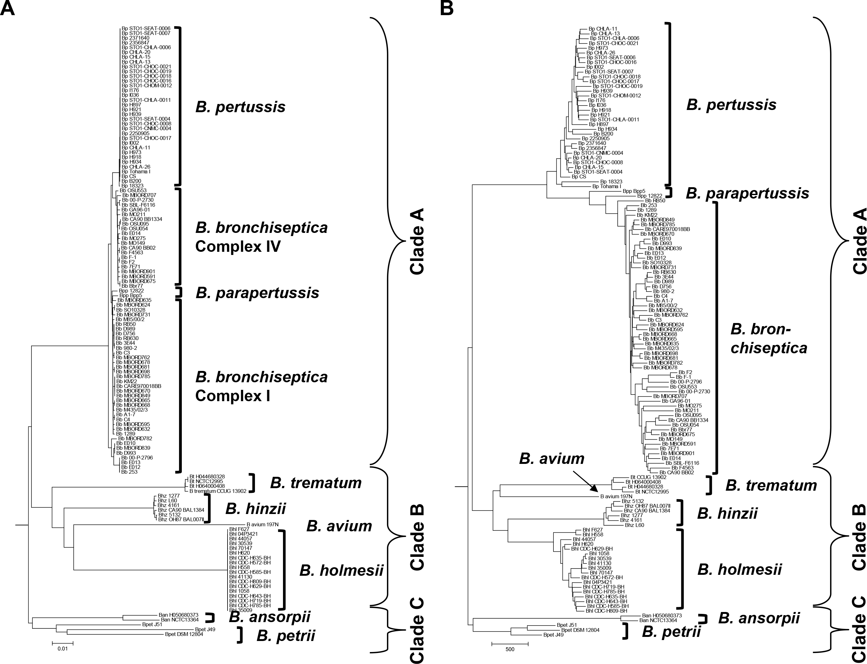
Display tree
SNP-based tree

Slide 32
SNP-based tree
gene presence/absence-based tree

Slide 33
Neighbor-joining trees of 16S rRNA gene sequences and
8 concatenated ATP synthase proteins from Bordetella
A) 16S rRNA
B. bronchiseptica
B. parapertussis
B. pertussis
B. hinzii
B. holmesii
B. trematum
B. petrii
B. avium
B. ansorpii
Burkholderia
0.01
B) ATP synthase
B. holmesii
B. hinzii
B. avium
B. pertussis
B. trematum
B. bronchiseptica
B. parapertussis
B. petrii
Ralstonia
B. ansorpii
Burkholderia
0.05

Slide 34
R: Calculate Distance matrices of SNPs and Genes
R: Calculate Mantel correlation between 2 phylogenies
a <-read.table(“fake5_gene1”, header = TRUE, sep = “\t”
## load data gene 1
x = t(a) ## transform data to genomes by row and SNPs by col
SEQ1.dist <- as.dist(dist(x, “manhattan”)) ## calc matrix
m1 <- as.table(SEQ1.dist) ## write as table
#############################################################
z <-read.table(“fake5_gene2”, header = TRUE, sep = “\t”
## load data gene 2
y = t(z) ## transform data to genomes by row and SNPs by col
SEQ2.dist <- as.dist(dist(y, “manhattan”)) ## calc matrix
m2 <- as.table(SEQ2.dist) ## write as table

Slide 35
R: Calculate Distance matrices of SNPs and Genes
R: Calculate Mantel correlation between 2 phylogenies
m3 <-mantel.rtest(SEQ1.dist, SEQ2.dist, nrepet = 99999)
fileConn <- file(“output.txt”)
write.lines(paste(m3[2:4], sep = “\t”), fileConn)
close fileConn
cat output.txt
extract values from output.txt
cat output.txt | awk ‘NR==1’ > t1
cat output.txt | awk ‘NR==2’ > t2
cat output.txt | awk ‘NR==3’ > t3
printf “r = $(cat t1) \n nrepet = $(cat t2) \n p-value = $(cat t3) \n” >> $NAMEGENE1-$NAMEGENE2.out

Slide 36
extract values from output.txt
cat output.txt | awk ‘NR==1’ > t1
cat output.txt | awk ‘NR==2’ > t2
cat output.txt | awk ‘NR==3’ > t3
printf “r = $(cat t1) \n nrepet = $(cat t2) \n p-value = $(cat t3) \n” >> $NAMEGENE1-$NAMEGENE2.out
cat $NAMEGENE1-$NAMEGENE2.out
Dataset from file ‘9BordetellaSNP’: 265372 loci.
Dataset from file ‘ATPsynthase_AA’: 2125 loci.
r = 0.65755
nrepet = 99999
p-value = 0.00483
# R^2 = 0.4324

Slide 37
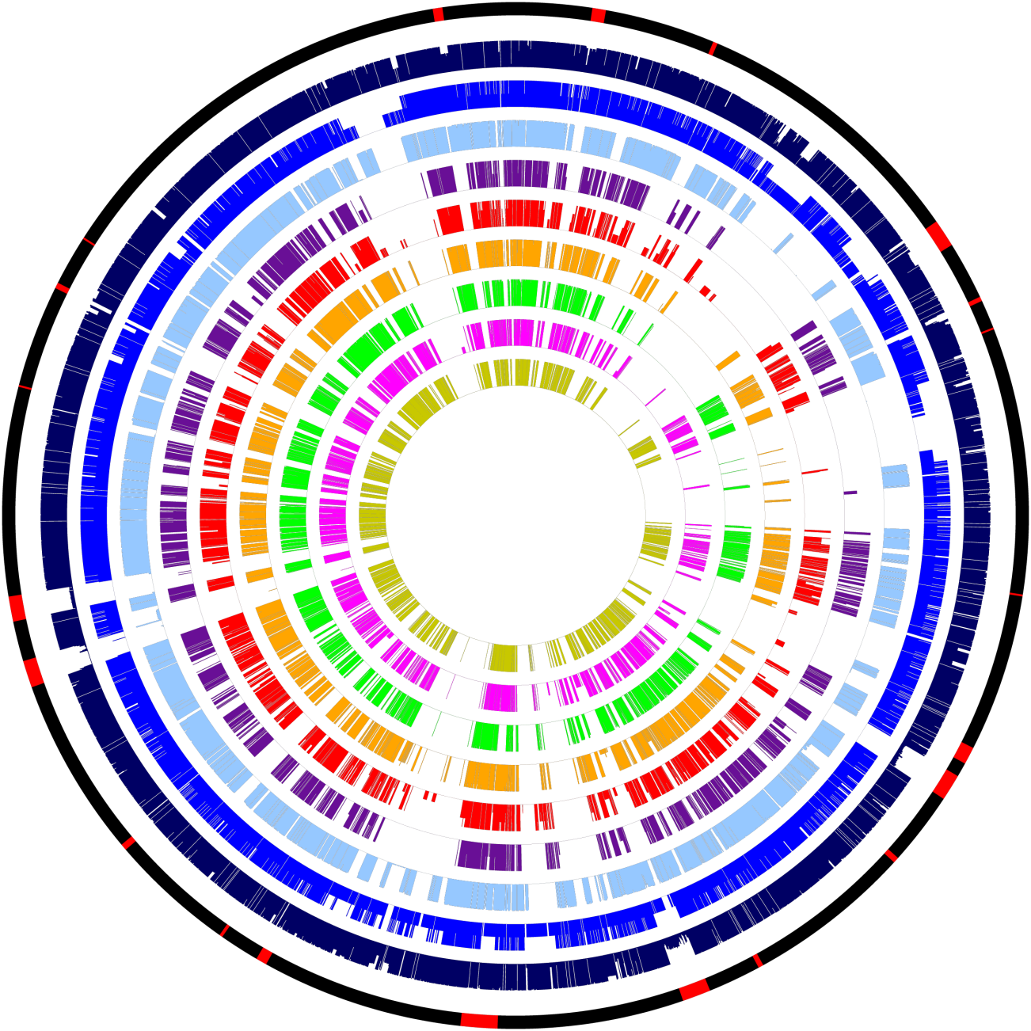
Presence and absence of genes in 128 genomes from 9 Bordetella species
PT
O-antigen
ACT
Virtual chromosome of
the B. bronchiseptica
RB50 reference genome
with key factor genes or
gene clusters in red.
Proportion of genes
present in individual
genomes per species
color-coded by
species.
A thin line for each gene
indicates the percentage
of genomes in each
species containing this
gene.
colored: gene(s) present
white: gene(s) absent
Φ – prophage
Heme
Pilus D
T6SSa
Φ
Φ
BrkB
DNT
Alca-
ligin
Φ
PRN
Φ
T3SS
Φ
Pilus C
Pilus A
BvgAS
FhaB
Enterobactin
Capsule A
Pilus B
Capsule A
Φ
Flagella/
Chemotaxis

Slide 38
Presence and absence of genes in 128 genomes from 9 Bordetella species
PT
O-antigen
ACT
Heme
Pilus D
T6SSa
Circles
1: Virtual chromosome of
B. bronchiseptica RB50
with genes of interest;
2: B. bronchiseptica
(based on 58 genomes);
3: B. parapertussis (2);
4: B. pertussis (34);
5: B. ansorpii (2);
6: B. petrii (3);
7: B. hinzii (6);
8: B. holmesii (18);
9: B. trematum (4);
10: B. avium (1)
Φ
Φ
BrkB
DNT
Alca-
ligin
Φ
PRN
Φ
T3SS
Φ
Pilus C
Pilus A
BvgAS
FhaB
Enterobactin
Capsule A
Pilus B
Capsule A
Φ
Flagella/
Chemotaxis

Slide 39
Massive gene loss during the evolution of B. pertussis
from a B. bronchiseptica - like ancestor
Circles
1: Virtual chromosome of
B. bronchiseptica RB50
with genes of interest;
2: B. bronchiseptica
(based on 58 genomes);
3: B. parapertussis (2);
4: B. pertussis (34);
5: B. ansorpii (2);
6: B. petrii (3);
7: B. hinzii (6);
8: B. holmesii (18);
9: B. trematum (4);
10: B. avium (1)
Pilus D
T6SSa
Φ
Φ
BrkB
DNT
Alca-
ligin
Φ
PRN
Φ
T3SS
Φ
Pilus C
Pilus A
BvgAS
FhaB
Enterobactin
Capsule A
Pilus B
Capsule A
Φ
Flagella/
Chemotaxis

Slide 40
ACT – Artemis Comparison Tool
B. pertussis
B. bronchiseptica
B. parapertussis
Parkhill et al 2003 Nat Genet 35: 32-40

Slide 41
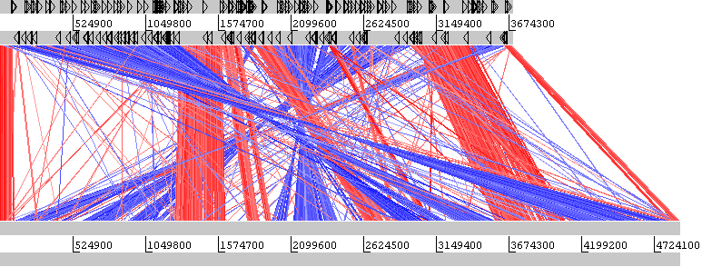
B. holmesii
B. hinzii
80% of chromosomal breakpoints are flanked by IS-elements
Linz et al 2016 BMC Genomics 17: 767

Slide 42
How to perform a genome comparison and display in ACT?
Whole Genome Blast – genome comparison
MSPcrunch – change blast format to Artemis input
# need fasta files of both genomes
# generate data base, use “formatbd”
formatdb –i genome1.fasta –p F –o T
# -i: input Fasta file
# -p: T input type protein, F nucleotide sequence
# -o: T output database NCBI styled, F none
# output:
# genome1.nhr
# genome1.nin
# genome1.nsd
# genome1.nsi
# genome1.nsq

Slide 43
How to perform a genome comparison and display in ACT?
Whole Genome Blast – genome comparison
MSPcrunch – change blast format to Artemis input
# need fasta files of both genomes
# run blastn
# syntax: blastall –p [program] –d [database] –i [subject genome] –b [max hits] –v [max hits] –o [output file]
blastall –p blastn –d genome1.fasta –i genome2.fasta –o genome1-genome2.out –v 1000000 –b 1000000
Query: 4599606 tggtgaggtcgggcgaatcgtcca
|||||||||||| |||||||||||
Sbjct: 4074107 tggtgaggtcggacgaatcgtcca
Query: 4599666 caggagcttgttgcattgcgatgc
|||| ||||||||||||||||||
Sbjct: 4074047 cagggacttgttgcattgcgatgc

Slide 44
How to perform a genome comparison and display in ACT?
Whole Genome Blast – genome comparison
MSPcrunch – change blast format to Artemis input
# take blast output and change format to table
MSPcrunch –d genome1-genome1.out > genome1-genome2.cmp
what you get:
score % sim from to gen1 from to genome2
10689 99.58 181497 183650 AXSJ 1 2154 Bb_RB50
8233 99.82 183699 185350 AXSJ 2143 3794 Bb_RB50
# so, we got:
# genome1.fasta (or genome1.gbk)
# genome1-genome2.cmp
# genome2.fasta (or genome2.gbk)

Slide 45
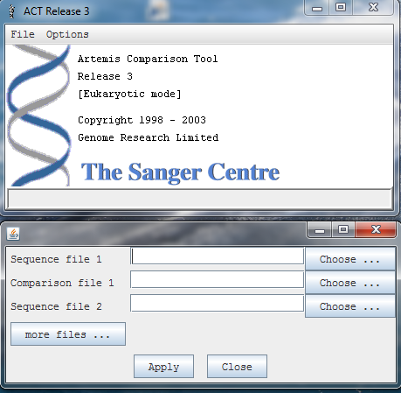
Load your files in ACT
genome1.fasta (or genome1.gbk)
genome1-genome2.cmp
genome2.fasta (or genome2.gbk
https://www.sanger.ac.uk/science/tools/artemis-comparison-tool-act

Slide 46
Blastall and MSPcrunch - Download, install and run
Blastall
go to: ftp://ftp.ncbi.nlm.nih.gov/toolbox/ncbi_tools/old
select toolbox folder, e.g. 20120620
click on ncbi.tar.gz to download
go to "Downloads" on your computer
to unpack type: tar -xvzf ncbi.tar.gz
to make type: ./ncbi/make/makedis.csh
change directory: cd ncbi/bin
copy everything to: /home/[user]/bin (change to your bin directory)
MSPcrunch
Get MSPcrunch from:
http://sonnhammer.sbc.su.se/download/software/MSPcrunch+Blixem/
install (or get the compiled program from me)

Slide 47
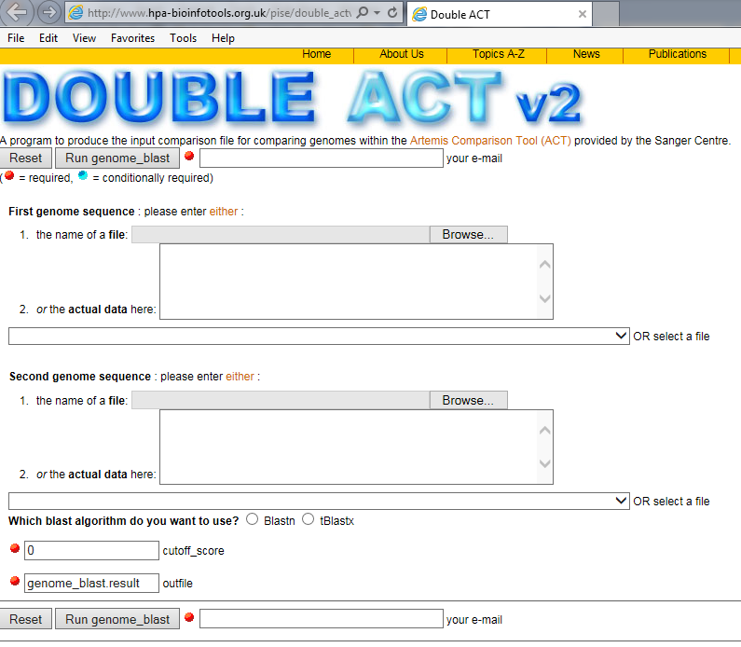
Alternatively: internet double_ACT
www.hpa-bioinfotools.org.uk/pise/double_actv2.html
Pro: choice between
blastn
= sequence vs sequence
or tblastx
= translated seq
vs. translated seq
Con: - slower
- get email with a link
- open the output file
- select all, copy
- paste in text editor
- save as comparison file

Slide 48
Let’s shift gears:
run genome comparison against multiple genomes in a loop
genome1: BhinziiL60.fasta vs genome2: BhinziiF582.fa
BhinziiH568.fa
BhinziiNCTC.fa
Bhinzii5132.fa
Bhinzii1277.fa
BhinziiCA90.fa
#!/bin/bash
# multiple_genomes_to_ACT.sh
# Author Bodo Linz
# run BLASTn and MSPcrunch for several genomes
DATABASE=BhinziiL60.fasta
BLASTALL=~/bin/blastall # define location of program blastall
MSPCRUNCH=~/bin/MSPcrunch # define location of program MSPcrunch
GENOME1=${DATABASE%%".fasta"} # database name without “.fasta”
# has the database already been formatted?
if [ -f ${DATABASE}.nhr -a ${DATABASE}.nin -a ${DATABASE}.nsd -a ${DATABASE}.nsi -a ${DATABASE}.nsq ]; then \
echo "The database is already formatted"
else
formatdb -i ${DATABASE} -p F -o T
echo "Done formatting the database $GENOME1.fasta"
fi

Slide 49
Let’s shift gears:
run genome comparison against multiple genomes in a loop
genome1: BhinziiL60.fasta vs genome2: BhinziiF582.fa
BhinziiH568.fa
BhinziiNCTC.fa
Bhinzii5132.fa
Bhinzii1277.fa
BhinziiCA90.fa
# list the genomes to compare
files=$(ls Bhinzii*.fa)# generate list of files
# BLAST the target sequence against the reference genome
echo "Running blastn of $GENOME1 against
$files"
echo "------------------------------------------"
echo ""
for file in $files; do GENOME2=${file%%".fa"}; $BLASTALL -p blastn -d $DATABASE -i $GENOME2.fa -o $GENOME1-$GENOME2.out; done
# loop: for every file in list $files; do something; done
echo "Done with BLAST of $GENOME1 against
$files"
echo "------------------------------------------"

Slide 50
Let’s shift gears:
run genome comparison against multiple genomes in a loop
genome1: BhinziiL60.fasta
genome2: BhinziiF582.fa, BhinziiH568.fa, BhinziiNCTC.fa, Bhinzii5132.fa, Bhinzii1277.fa, BhinziiCA90.fa
# Now: do the same for MSPcrunch
# list the BLAST output files
files=$(ls Bhinzii*.out) # BhinziiL60-BhinziiF582.out etc.
# transform the blast output to ACT *.cmp table in MSPcrunch
echo "Running MSPcrunch of files
$files"
echo ""
echo "------------------------------------------"
echo ""
for file in $files; do name=${file%%".out"}; $MSPCRUNCH -d $name.out > $name.cmp; done
echo "Done with MSPcrunch."
echo "------------------------------------------"
echo ""
echo "Done. Run ACT to visualize the genome comparison."
echo ""

Slide 51
To be continued
on Sept. 25th
Thank you.

